Slide 1
What is .Net Standard? How it is different from .Net Core and Portable Class Library?

Slide 2
.Net Standard is a specification which dictates what the Base Class Libraries of different .Net platforms should implement to unify the Base Class Libraries of different .Net Platforms.
Here, Platform means full .NetFramework, .Net Core, Xamarin, Silverlight, XBox etc. This also enables code sharing between applications that runs on these different platforms.
For example, a library or a component that is developed on top of a platform that implements specific .Net Standard version can be shared by all the applications that runs on any of the platforms that implements same .Net Standard version.

Slide 3
.Net Standard is not a framework or platform of its own. It does not have implementations or a runtime, it just defines a specification what different .Net platforms has to implement to remain .Net Standard complaint. For Instance, .Net Core is a framework with runtime that implements .NetStandard.
In other words, .Net Standard defines a set of API’s that the platforms has to implement to be complaint with .Net Standard. By implementing this specification, the base class libraries of different platforms are unified which were otherwise evolving independently though many of the library functions are common.

Slide 4


Slide 5
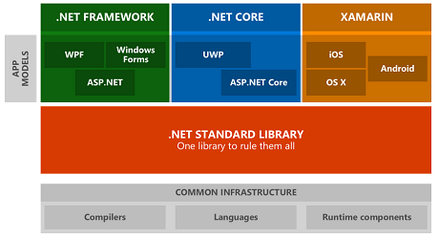
.NET Standard is a set of APIs that all .NET platforms have to implement. This unifies the .NET platforms and prevents future fragmentation.
.NET Standard 2.0 will be implemented by .NET Framework, .NET Core, and Xamarin. For .NET Core, this will add many of the existing APIs that have been requested.
.NET Standard will replace Portable Class Libraries (PCLs) as the tooling story for building multi-platform .NET libraries.

Slide 6
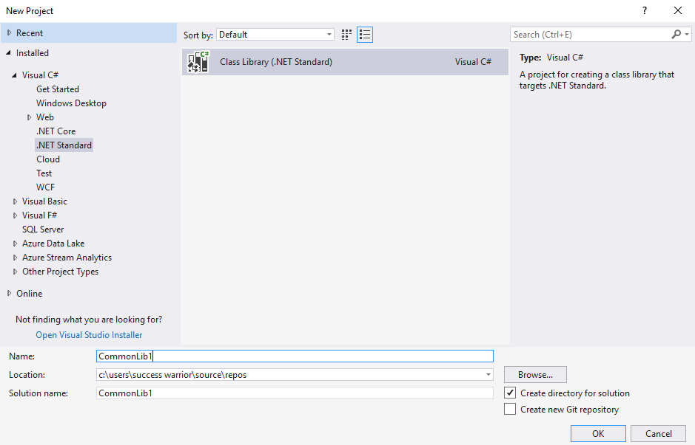

Slide 7
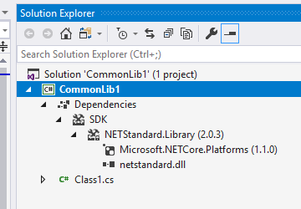

Slide 8
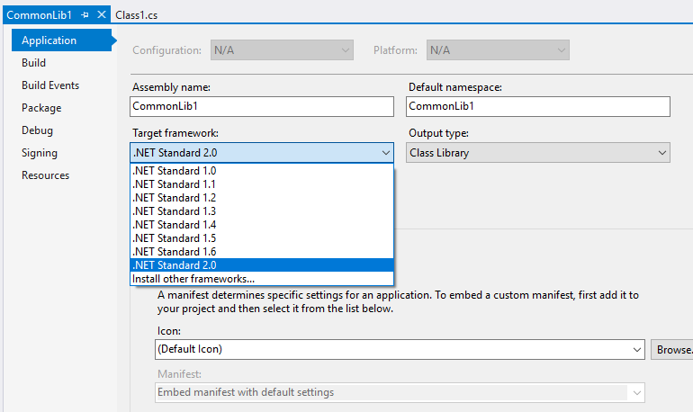

Slide 9
